Slide 1

C o n c e p t u a l W o r k f l o w M o d e l
U S E R
O F F I C E
O N S I T E
Contractor is assigned a project based on their expertise and area.
Inbox
Folders
When email is received
(i.e. Report Submitted)
Once contractor is on site they will mark the job as “In Progress”,
Report Submitted
Lighting
Potholes
Etc...
Based on the category selected (icon – lighting, pothole, etc.)
System Notification Sent (via Email or API call to backend system) Automatically routes the report to the correct category folder based on (subject & location)
Folders are preset and
based on the (subject & Location) will be assigned to the correct project team to action.
then “Completed” once done.
Area_1
Area_1
Area_2
Area_2
Updates the “All Reports” tab status to “Logged”.
Etc…
The “All Reports” Tab is updated so user can view all their submissions
(full submission with photos)
Quality Control / Escalation Management or Audits
Sign-off needed before marking anything as “completed”
The contractor will finish the job and send it back to the office. Once someone at the office checks and signs it off, the report will be marked as “Completed” in the system.
The user will then get an automatic email to say the issue is sorted.
The report will also show as “Completed” in their “All Reports” tab after this.
Live update in the “All Reports” Tab
Logged
In Progress
Completed

Slide 2
Vision / mission statement / views in about section
About
All Reports
Feedback
FAQ’s
How does it work?
Resolution process
Customer Feedback
Jotform ChatBot – for FAQ’s
Software / applications used
* Creative Fabrica - Mockups
Video Presentation
Create Studio 3

Slide 3
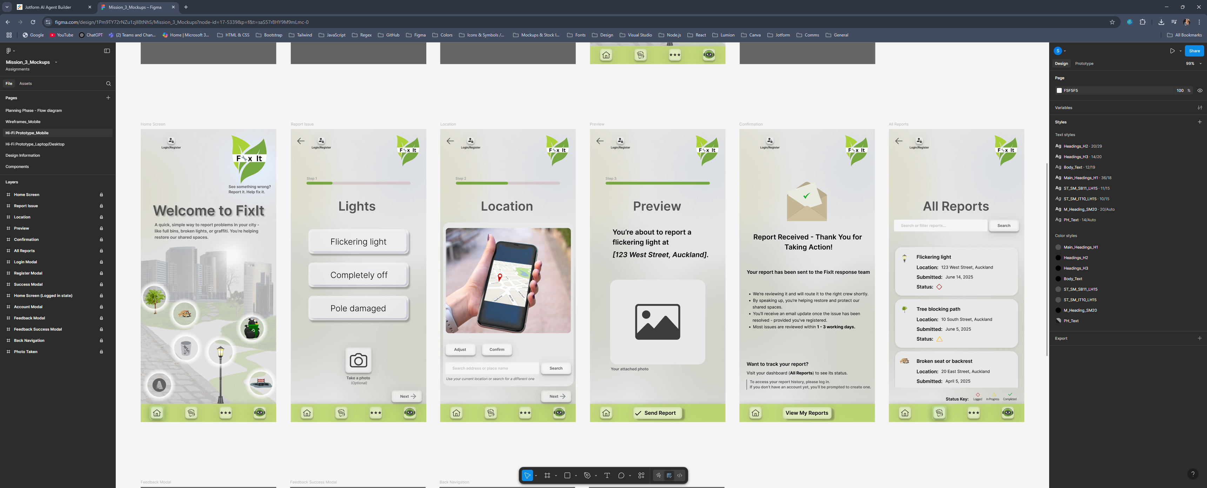
#77A741
#ABD038
#BFD679
#AEC373
#DAE5B7
#D1D5CB

